Slide 1
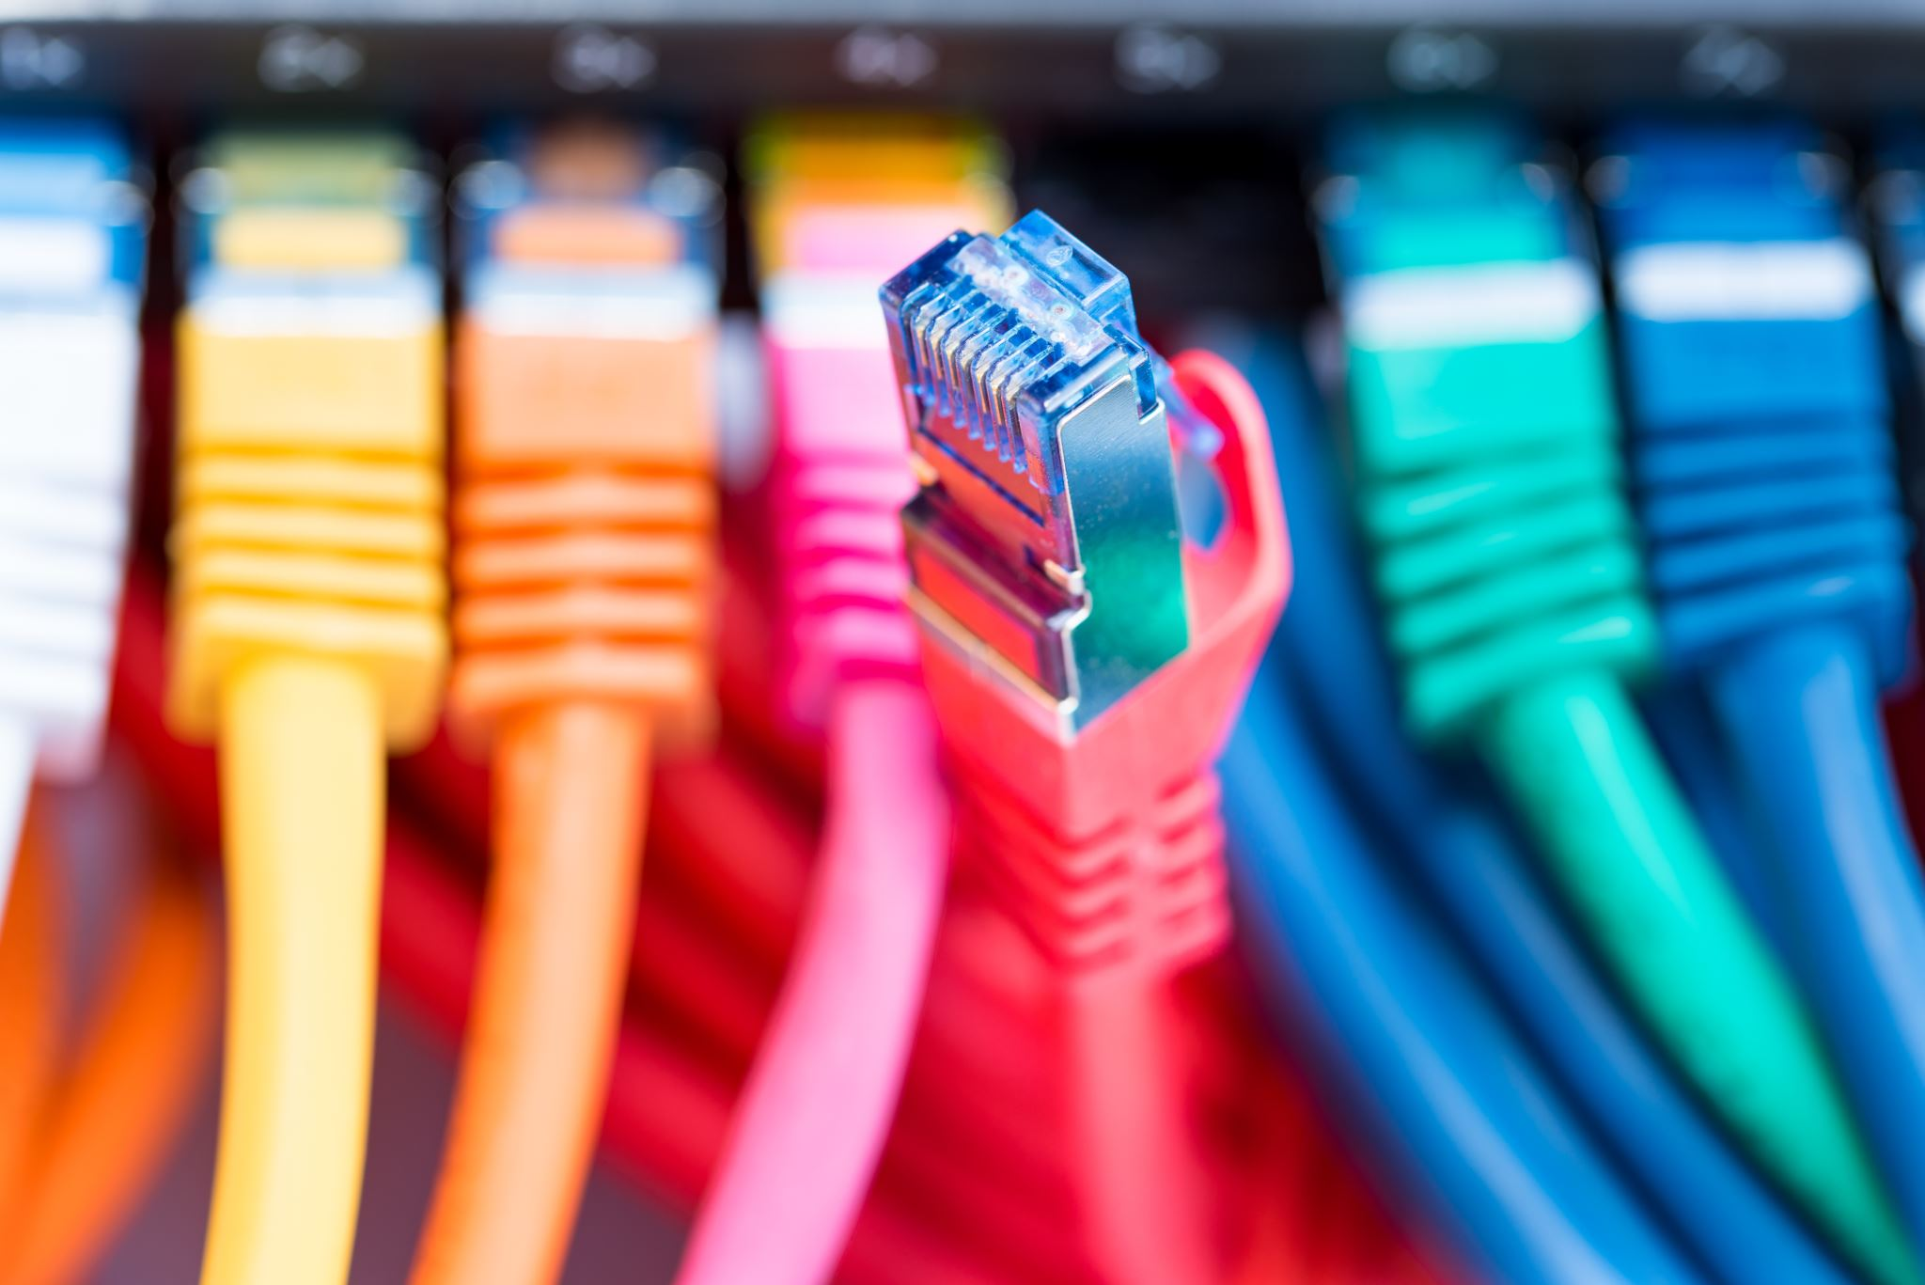
Lan Design
By Daniel, Oksana, Tegan, Eryk, Calvin and Donal

Slide 2
Lan Design
Mapping the MDF, IDFs

Slide 3
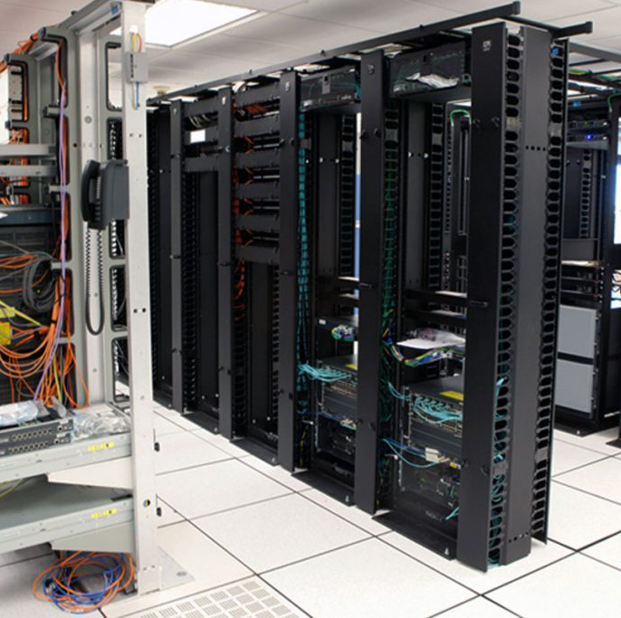
Mapping the MDF and IDFs
Everyone in our group has participated in the placements of the MDF, the IDFs and the scouting of rooms to give appropriate port numbers per room.
We have decided to place the MDF on the 2nd floor in room 2284 as it is in the middle of the University.

Slide 4
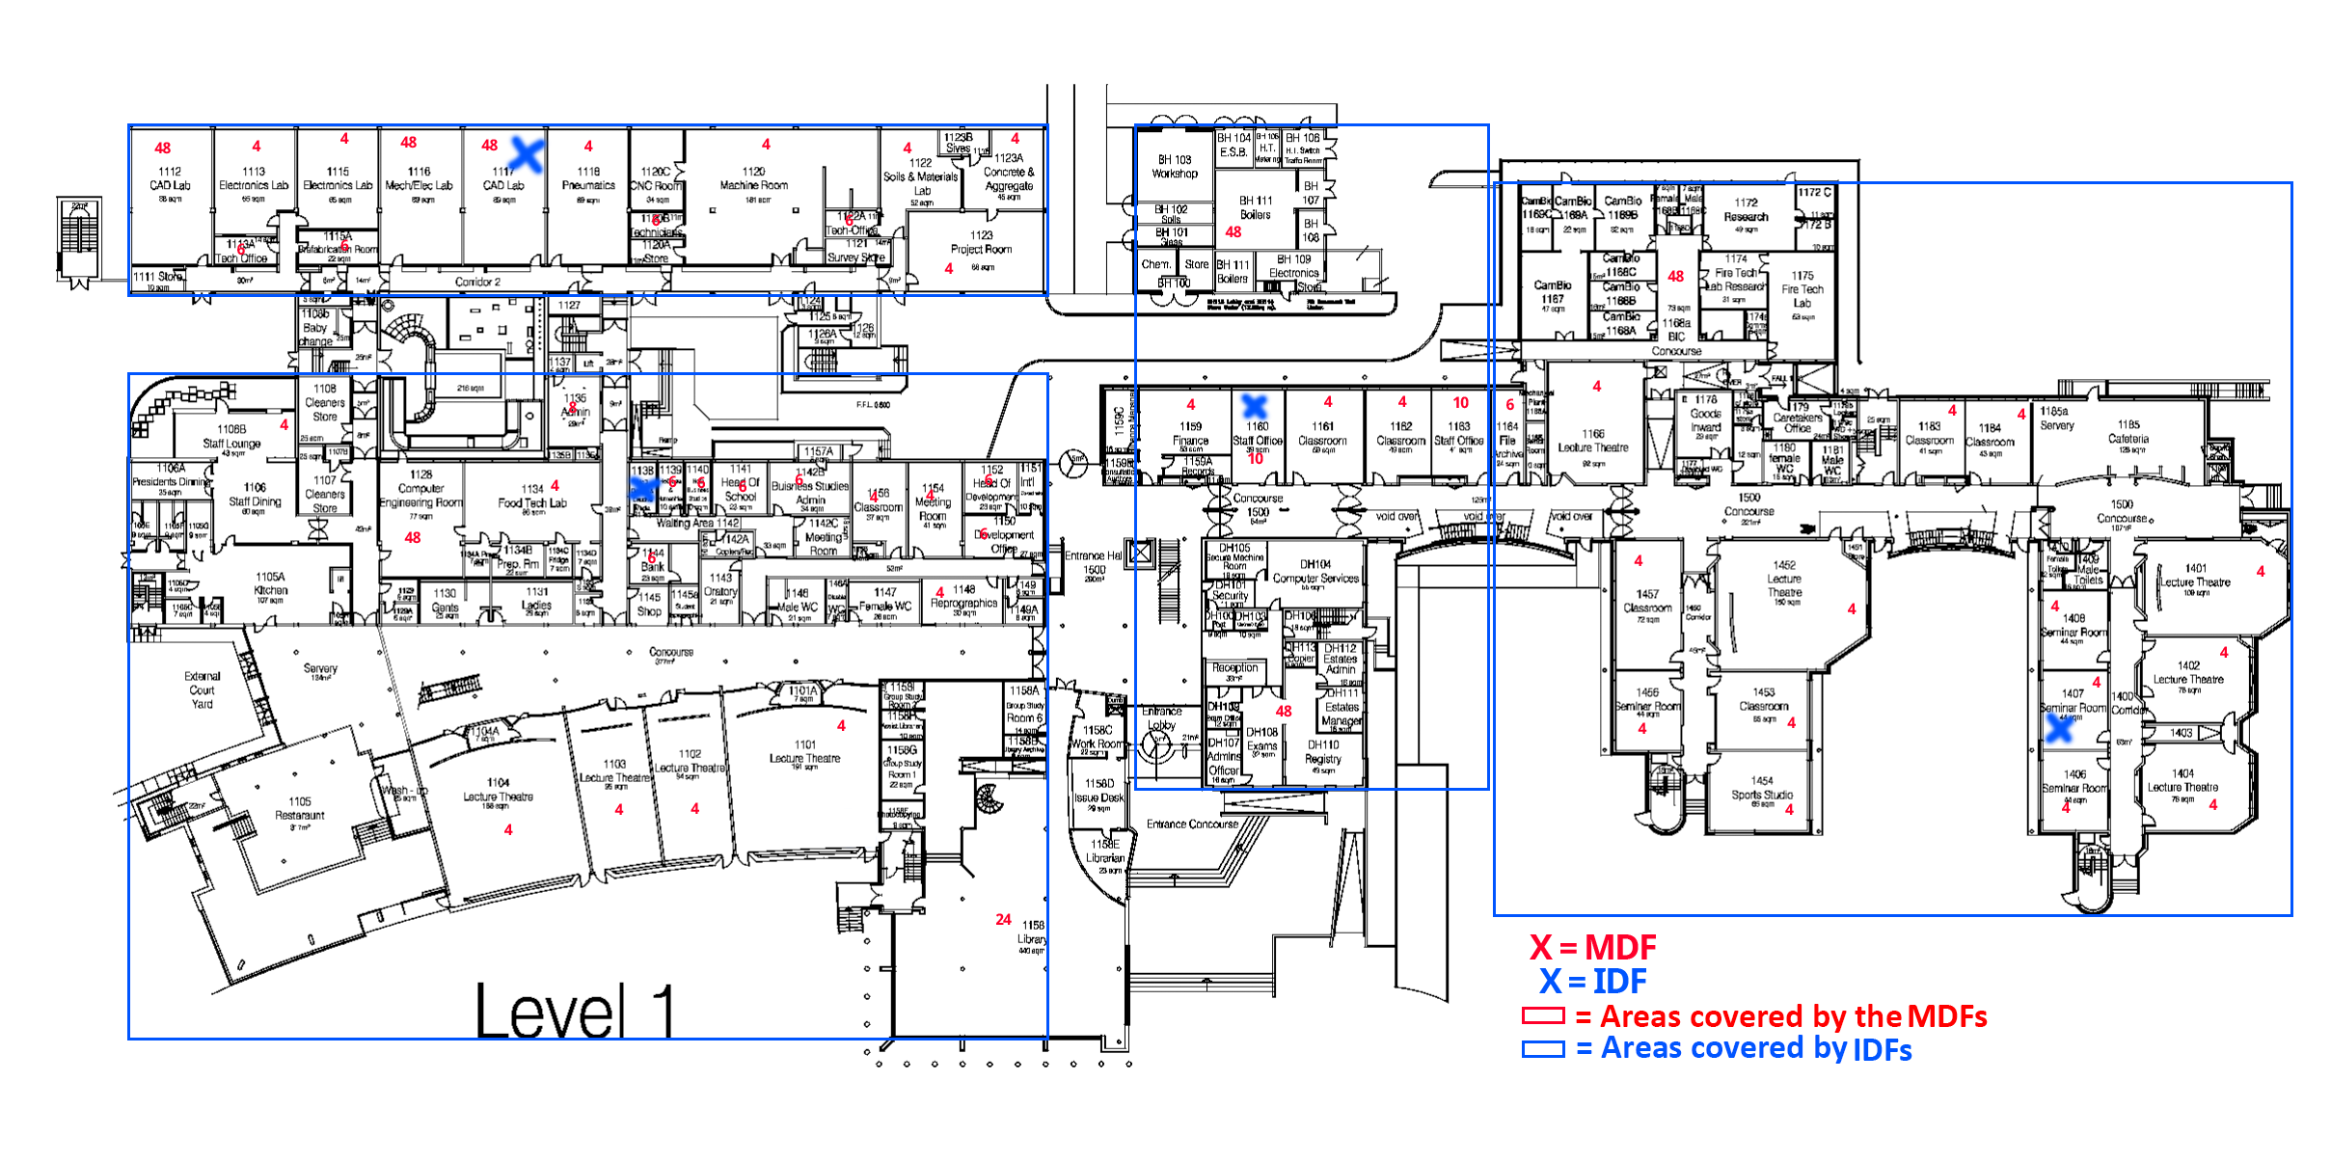
Floor 1
Floor 1 is having the second largest number of hosts and it has 4 IDFs.
The IDFs on floor 1 are in rooms: 1117, 1138, 1160 and 1407.

Slide 5
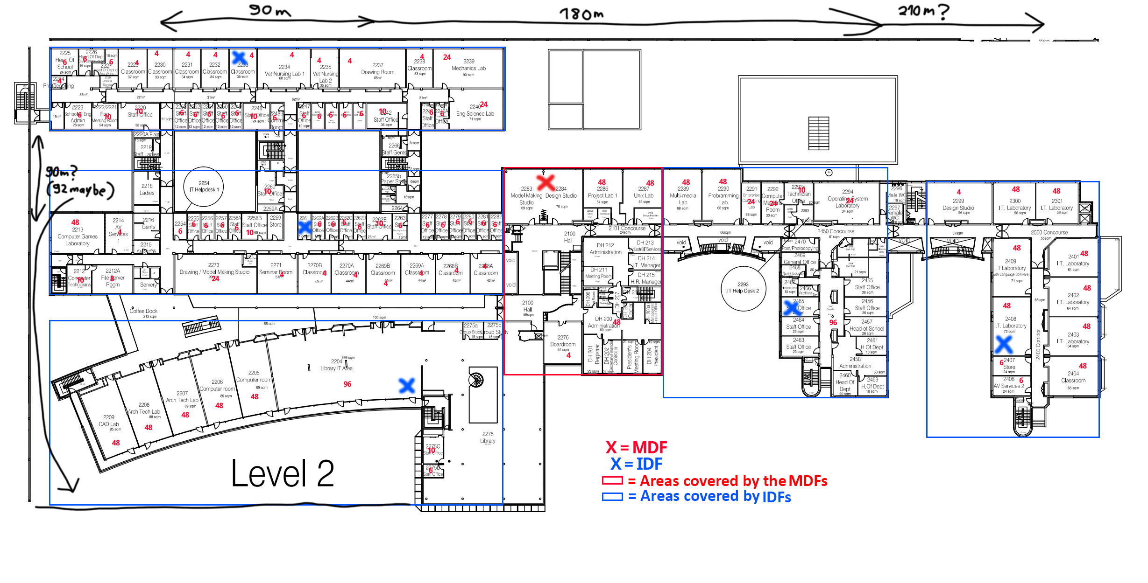
Floor 2
Floor 2 has the highest number of hosts, and it has 5 IDFs.
Floor 2 also has an MFD.
The IDFs on floor 2 are in rooms: 2204, 2233, 2261, 2248 and 2465.

Slide 6
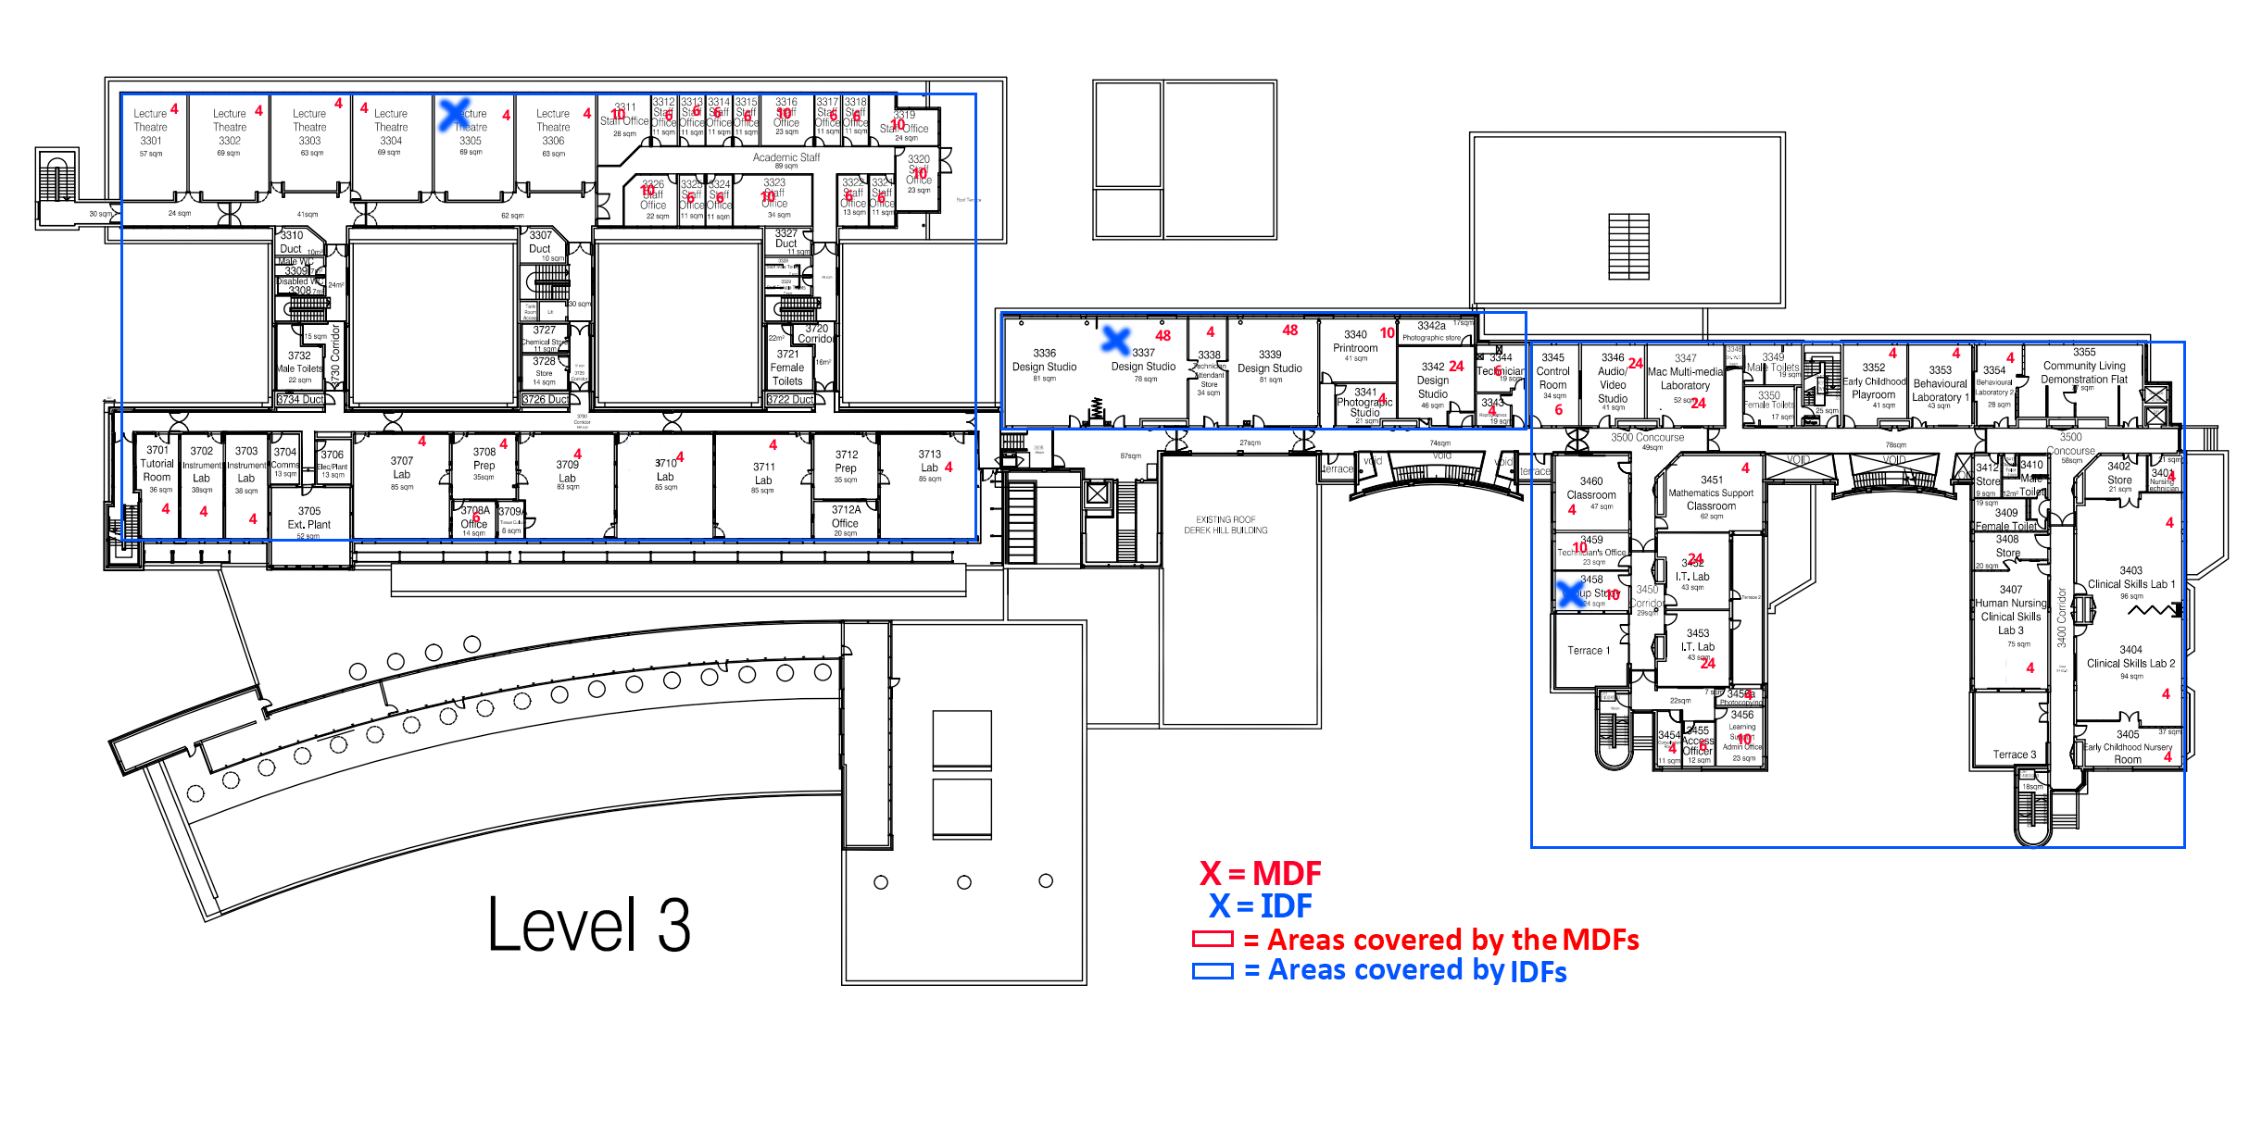
Floor 3
Floor 3 has the smallest number of hosts, therefore it has only 3 IDFs.
The IDFs on floor 3 are in rooms: 3305, 3337 and 3458.

Slide 7
Lan Design
Subnets and VLANs.

Slide 8
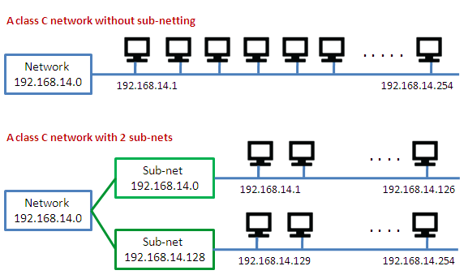
Subnets and VLANs
We will be using a Class B Private Address for the network, which will be 172.19.0.0/16.
As we need to at least allocate 14 Subnets, we will use 4 bits, the subnet mask will be 255.255.240.0, the C.I.D.R mask will be /20 and the available Subnets will be numbered from 0 to 15.
Network Address Translation(NAT) will be used to translate the private address into a public address.
There is a VLAN for each Subnet that is present.
There is also a DHCP Server used for each Subnet.
The two last Subnets are used for redundancy.

Slide 9
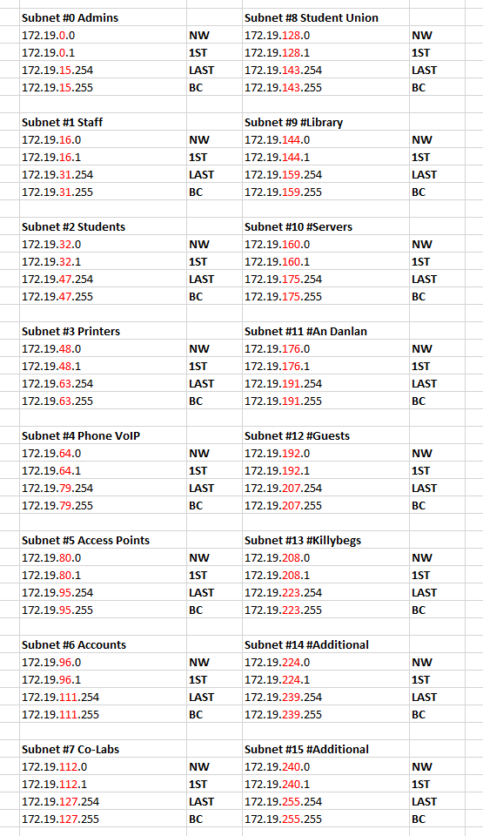
Subnets and VLANs

Slide 10
Lan Design
Access Points

Slide 11
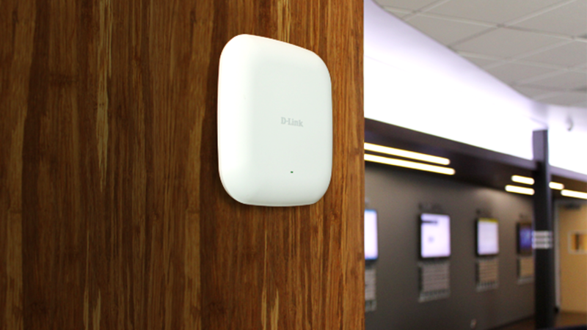
Access Points
The access points that we will be using are of the 2.4GHz frequency because they can travel through thin room walls and have roughly 45 meters of distance compared to 5GHz frequency that cannot travel through thick floor walls and have a shorter distance.
The access points will be placed on floor 1 and floor 3.
The access points were placed to have an overlap of 20% around other access points.
Access Points also have a Subnet and VLAN of their own.

Slide 12
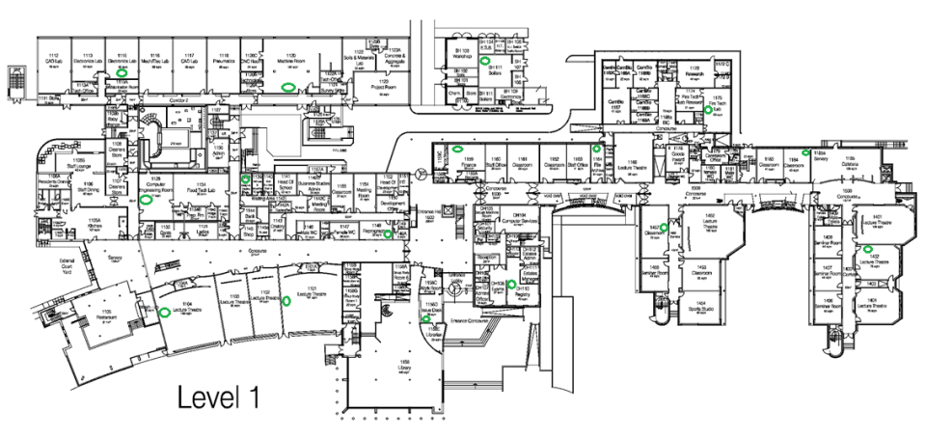
Floor 1 Access Points

Slide 13
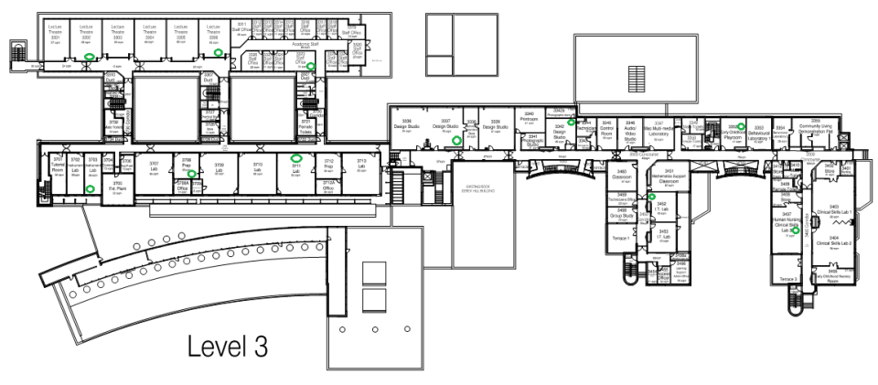
Floor 3 Access Points

Slide 14
Lan Design
Cabling

Slide 15



Cat6a
Fiber Optic Cable
LC Connector/RJ45
Horizontal Cabling
Backbone cabling
Notes:
15

Slide 16
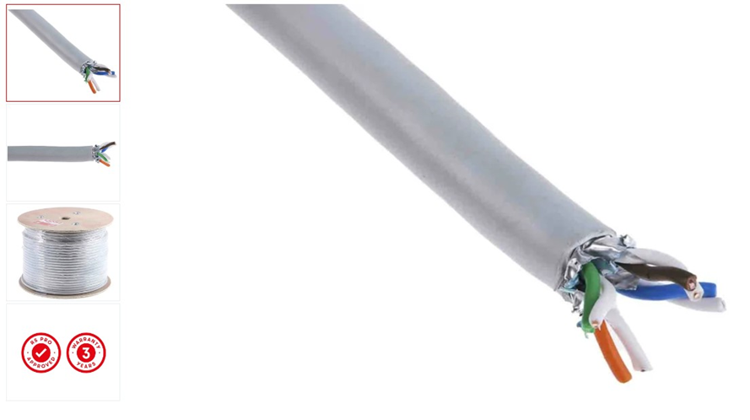
Cat6a Cable
Cat6a cable suitable for home, office and industrial networks requiring a reliable internet connection. These cables are LSZH (Low Smoke Zero Halogen) ensuring health and safety standards are met in the even of it being near a high heat source. Being Cat6a, these shielded ethernet cables have a copper conductor and are suitable for 10 gigabit per second networks and will provide a frequency of up to 500 MHz, both at 100 m.
A Cat6a cable or Category 6a cables are a high-speed type of ethernet cable or patch cable as they're also known. They are used as a commonly within various types of industries and workplaces, including offices and warehouses requiring a network connection. Anywhere which has an internet connection, it's almost a guarantee you'll find one of these network cables.

Slide 17
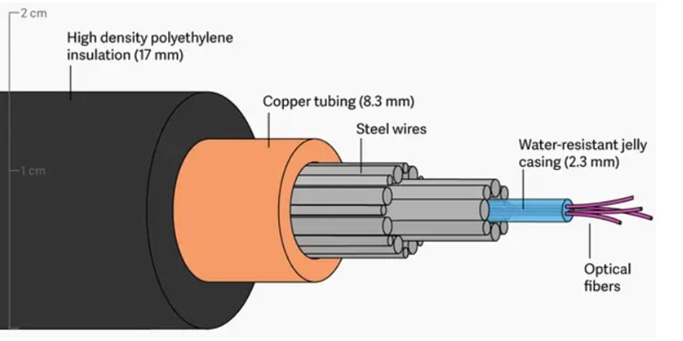
Fiber Optic Cable
Fiber optics is the technology used by internet services transmit information as pulses of light through strands of fiber made of glass or plastic over long distances
Optical fibers are about the diameter of a strand of human hair and when bundled into a fiber-optic cable, they’re capable of transmitting more data over longer distances and faster than other mediums. It is this technology that provides homes and businesses with fiber-optic internet, phone and TV services.
A fiber-optic cable contains anywhere from a few to hundreds of optical fibers within a plastic casing. Also known as optic cables or optical fiber cables, they transfer data signals in the form of light and travel hundreds of miles significantly faster than those used in traditional electrical cables. And because fiber-optic cables are non-metallic, they are not affected by electromagnetic interference that can reduce speed of transmission. Fiber cables are also safer as they do not carry a current and therefore cannot generate a spark.

Slide 18
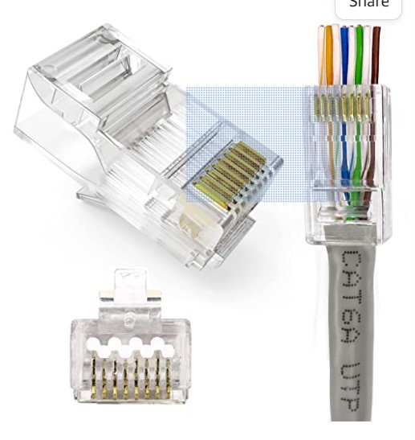
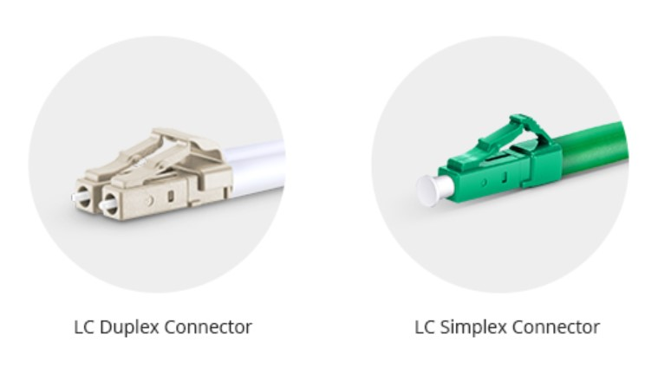
RJ45 Connector/LC Connector

Slide 19
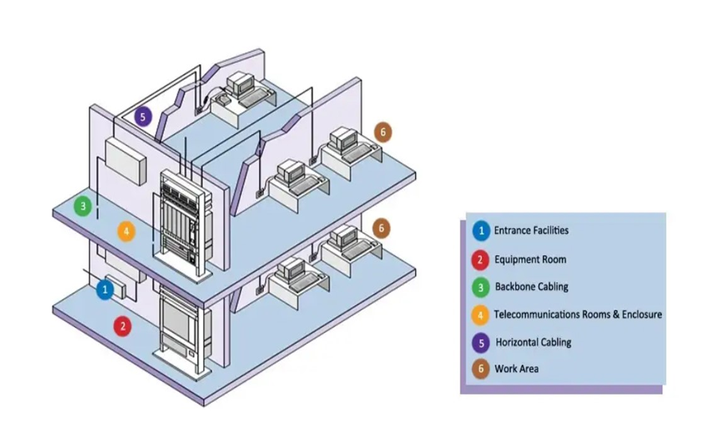

Slide 20
Horizontal Cabling
The horizontal cabling is all the cabling between telecommunications outlet in a work area and the horizontal cross-connect in the telecommunications closet, including horizontal cable, mechanical terminations, jumpers and patch cords located in the telecommunications room or telecommunications enclosure, multiuser telecommunications outlet assemblies and consolidation points. This type of wiring runs horizontally above ceilings or below floors in a building. In spite of the cable types, the maximum distance allowed between devices is 90 meters.

Slide 21
Backbone Cabling
Backbone cabling is also known as vertical cabling. It offers the connectivity between telecommunication rooms, equipment rooms, access provider spaces and entrance facilities. The cable runs on the same floor, from floor to floor, and even between buildings. Cable distance depends on the cable type and the connected facilities, but twisted pair cable is limited to 90 meters.

Slide 22
Lan Design
Servers and Services

Slide 23
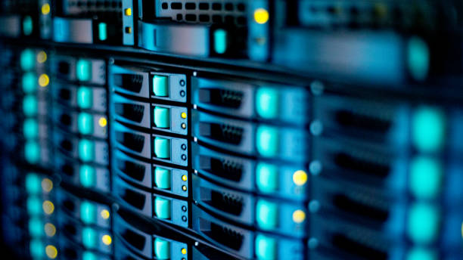
Servers
The servers that we are going to be using is the Dell PowerEdge Servers.
The Ip address that we will allocate to our servers is subnet 10 between 172.19.160.1 and 172.19.175.254.
The Server room will be in a low-traffic area and be properly secured so that only those who are authorized can access them.
Some servers will be near the MDF and some servers will be in a storage room.

Slide 24
File Servers
• The requirements for modest traffic up to 500 configured users and 25 simultaneous transfers.
A file server is a computer responsible for the storage and management of data files so that other computers on the same network can access the files.
It will enable users to share information over the network without having to physically transfer files.
The file server should have an RSCD agent installed and should be the same version as the Application Server. We wont limit access to the file server by pushing agent ACLs to the agent on the file server.
The file server will be located between clients and a local mass storage device.
Hardware | Minimum Requirement for Modest Traffic
CPU | 2 GHz+ multi-core
RAM | 2 GB+
Network | 10/100/1000 Mbps NIC
Hard drive space | 120 GB
Video | 128 MB Video RAM

Slide 25
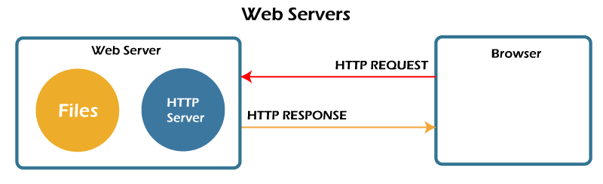
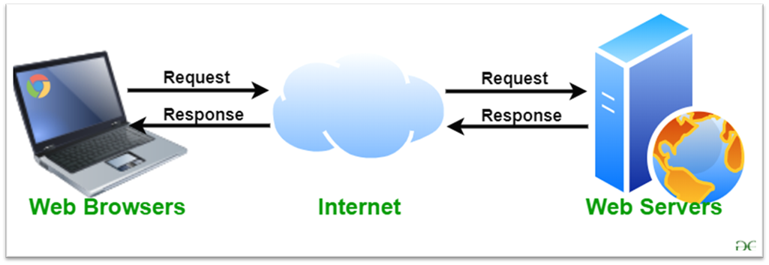
Web Servers
A web server is a computer that stores web server software and a website’s component files.
Web servers must respond quickly and deliver large files, especially when transferring complex multimedia objects like images or video clips.
Web servers are responsible for maintaining communication with an internal database server and will need to be placed into a DMZ, which provides an extra layer of security.
The types of web servers we will need are Apache HTTP Server, Nginx, and Microsoft’s IIS.
Hardware requirements for Web servers: Processor 2 x 1,6 GHz CPU, 3,5 GB RAM and 1x 40 GB of free space or more is recommended for the web shop data. 1x 40 GB of free space or more is recommended for software in the software requirements.

Slide 26
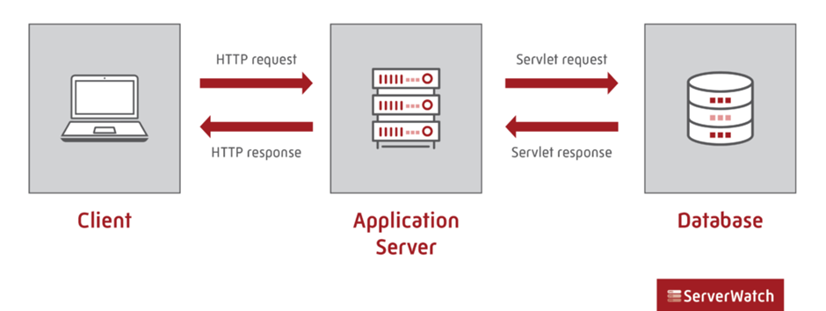
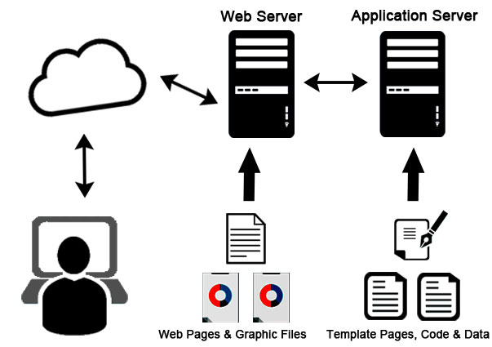
Application Servers
An application server is a server that hosts applications or software that delivers a business application through a communication protocol.
It is system software that resides between the operating system on one side, the external resources (such as a database management system [DBMS], communications and Internet services) on another side and the users’ applications on the third side.
We will use autocal which is a software suite that consists of a Windows application with a local database.

Slide 27
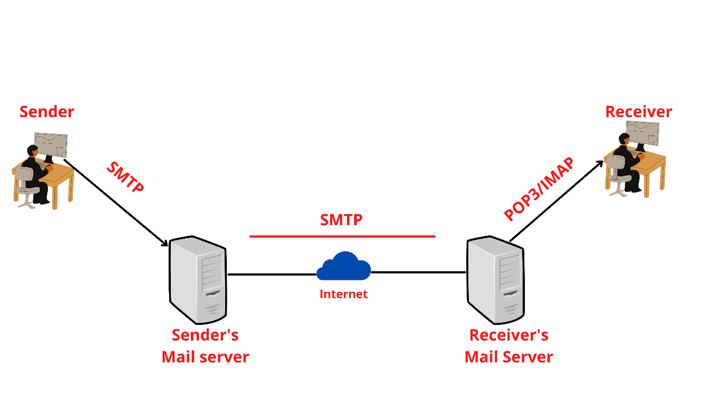
Mail Servers
A mail server also known as a mail transfer agent, or MTA; mail transport agent; mail router; or internet mailer is an application that receives incoming email from local users and remote senders and forwards outgoing messages for delivery.
The mail server will also be placed in the DMZ, to protect the hosts most vulnerable to attack.
• Email Server System Requirements
Users | Processor | RAM | Hard Drives
2500+ | 3.5 GHz Processor or higher with at least 8 cores | 32 GB | RAID 1 Array (System Drive) + RAID 10 Array (Mail Storage) + RAID 1 Array (Log Files)

Slide 28
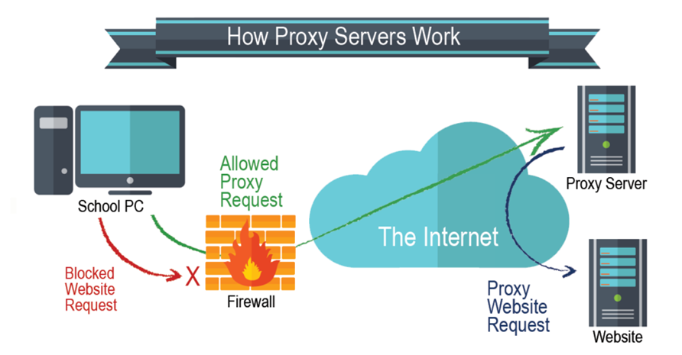
Proxy Servers
A proxy server is an intermediary server that retrieves data from an Internet source, such as a webpage, on behalf of a user. They act as additional data security boundaries protecting users from malicious activity on the internet.
The proxy server will reside between the user’s computer and the destination servers on the Internet.
The Proxy server should support GET, POST, and CONNECT methods. There should be connectivity between the Management Server and the proxy server.
There should be connectivity between the proxy server and the resources that the Management Server needs to access.
We will have a processor twice as fast as the minimum, as well as four times the minimum required memory — 2GHz and 2GB. 40GB of hard drive space. 32MB of Ram for each gigabyte of disk space set aside for caching.

Slide 29
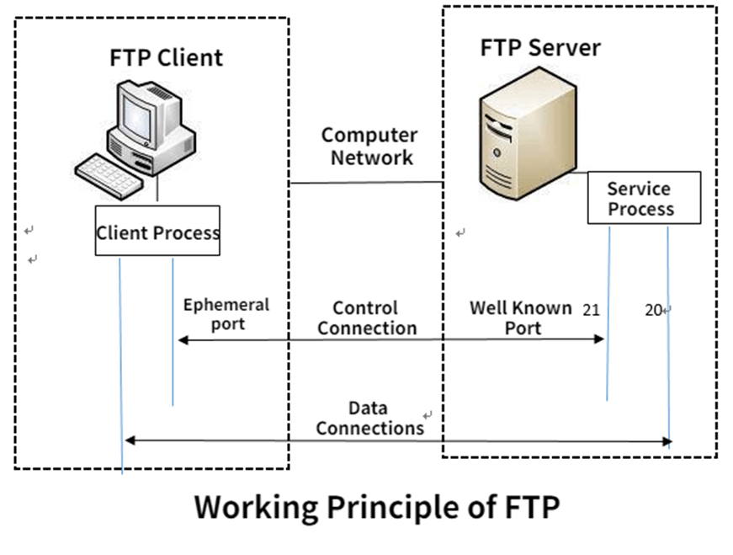
FTP Server
An FTP server is a computer program that is built to handle data transfer between computers.
The server waits for clients to connect to it and issue commands that tell the server to upload, download, or list directories.
The FTP protocol is the commands the FTP server uses to accomplish this.
For FTP to work, there needs to be a client and a server. The client connects to the service. The client and server communicate back and forth. The server must validate that the client has access to parts of the server it's trying to access, and then the client copies the files to the directories.
FTP runs on two different Transmission Control Protocol ports: 20 and 21. FTP ports 20 and 21 must both be open on the network for successful file transfers.

Slide 30
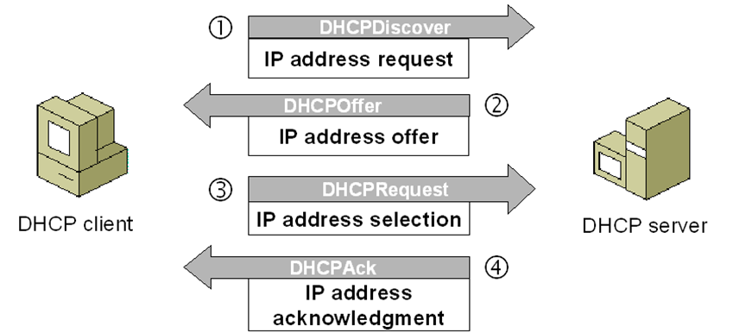
DHCP Server
Dynamic Host Configuration Protocol is an automatic configuration protocol used on IP networks.
DHCP allows a computer to be configured automatically eliminating the need for intervention by a network administrator.
It provides a central database for keeping track of computer’s IP allocation, this prevents two computers from accidentally being configured with the same IP address.
Computers must be configured with specific IP information before they can communicate with other computers even on their own subnet.
At minimum they need IP Addresses and a Subnet mask.
The DHCP Server works on ports 67 and 68

Slide 31
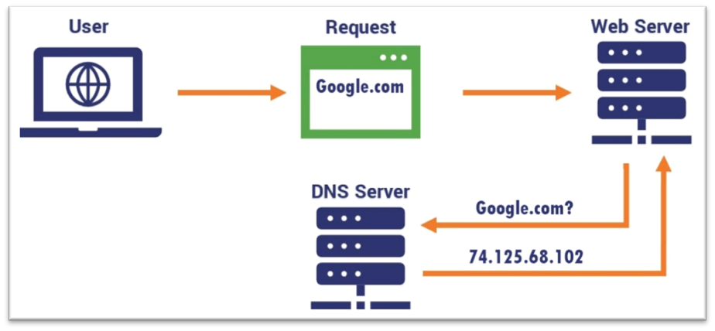
DNS
DNS is a hierarchical distributed database and is one of the components of the internet about which severer security concerns now exist, without a great deal of solutions on the horizon.
DNS was standardized in RFC1035 but a whole host of additional RFCs have been developed and the standard is in constant evolution.
We will use Linux and BIND for public DNS and Active Directory integrated Windows for internal DNS.
At minimum, we will need two DNS servers for each Internet domain we have. Relying on just one DNS server creates a single point of failure. If the primary server fails or is compromised by an attack, prospective visitors can no longer access the desired domain.

Slide 32
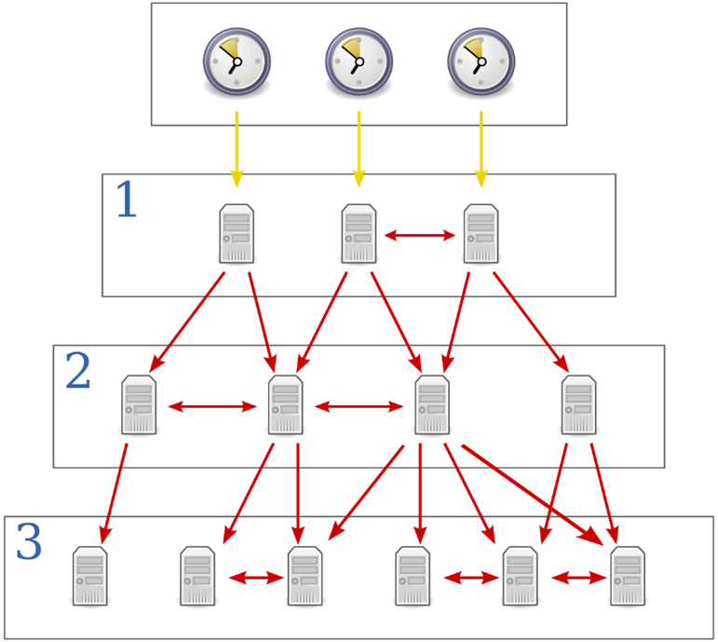
NTP
NTP is a protocol designed to synchronize the clocks of computers over a network to a common time base (usually UTC/GMT).
NTP is one of the oldest protocols still in use. To be accurate, it calculates a round trip delay time and offset. NTP uses UDP Port 123 as standard.
NTP is a UDP-based service. NTP servers use well-known port 123 to talk to each other and to NTP clients. NTP clients use random ports above 1023.

Slide 33
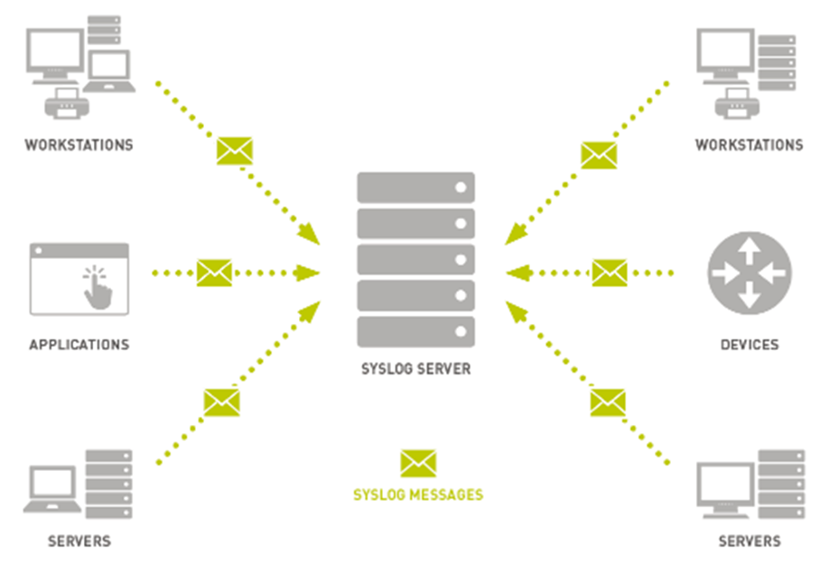
SYSLOG Protocol
The protocol provides a transport to allow a device to send event notification messages across IP networks to SYSLOG servers.
The protocol is designed to transport these event messages from the generating device to the collector.
The collector doesn't send back an acknowledgment of the receipt of the messages. Syslog is both a communications protocol and a set of programs and libraries.
Syslog runs on UDP, where syslog servers listen to UDP port 514, and clients (sending log messages) use a port above 1023.

Slide 34
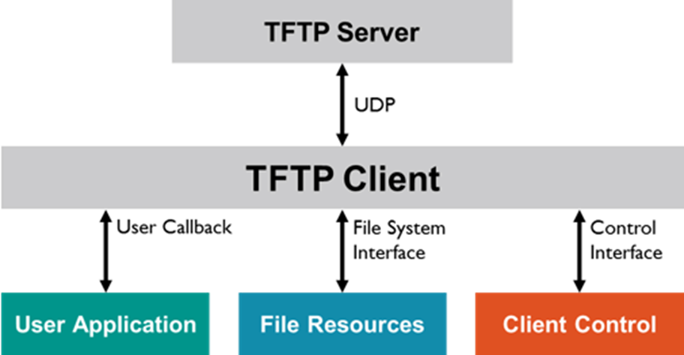
TFTP
Trivial File Transfer Protocol was designed as a cut-down version of FTP, with no authentication or security.
It is used as a standard by most networking equipment to copy images and configurations up and down from equipment.
When we set up our network for the first time, we will always need to apply a TFTP server to get and set configurations, firmware updates and software onto equipment.
It can be implemented in a very small amount of memory and is very economic on resources.

Slide 35
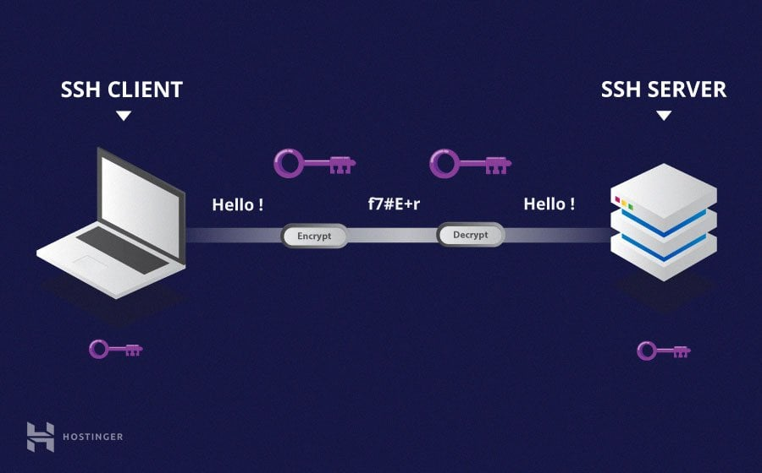
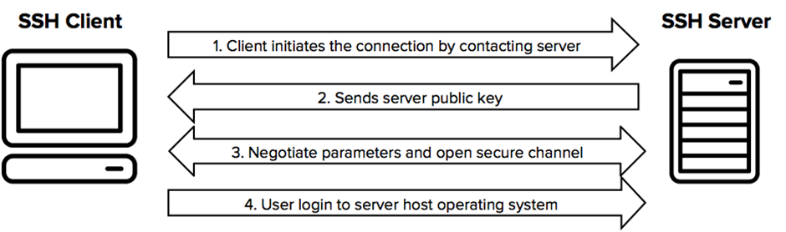
SSH
SSH allows secure access to a shell interface across public networks.
It uses public key cryptography to authenticate the remote computer. SSH was developed in 1995 by Tatu Ylonen of the Helsinki University of Technology in response to a password sniffing attack.
The Requirements for SSH are: Remote command invocation through SSH, Public-private key authentication and Support for Batch Mode yes interaction, which is the ability to invoke the SSH command without interaction from an operator.

Slide 36
Lan Design
Security

Slide 37
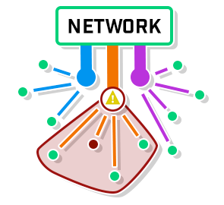
Using Subnets for a Secure Network
Subnets will be used to distribute the network. By breaking it up into multiple networks, an administrator has the ability to isolate the compromised network(s).
The network administrator can stop additional harm to the network and focus on fixing the immediate issue by being able to isolate the compromised network.
Subnetting can stop users from hopping around and landing in sections of the network they shouldn't be in, in addition to being able to contain and target threats.
An example of how the threat can be isolated
When the subnet administrator assigns a device an IP address, they also assign certain security responsibilities to the devices user.

Slide 38

Creating a Secure User Account
Contrary to popular belief, users will remember a random password. It may be difficult the first few times using the password, but any password that is used often enough is easy to remember.
The administrator assigns a password for each users account created. Problems with weak passwords are avoided by preventing the user from choosing their own password.
A student's or faculty member's account will be disabled if they have graduated or otherwise left the university.
It makes sense to deactivate these accounts for storage and security reasons as they won't need to access the system any longer. Unused accounts are a major target for hackers.

Slide 39
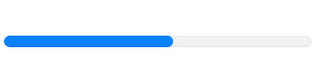


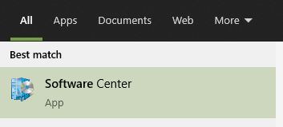
Installing Software and Applications
Only administrators have the access to install software. All computers will come with pre-installed software, the software will vary depending on the classes that will take place in that room.
Having the software pre-installed eliminates any threats from third party sites. It also prevents installation of any harmful or inappropriate applications. Each computer will have basic software already available.
Any additional software that may be required can be installed from the software centre. If something that’s needed isn’t available in the software centre they can request the administrator to add it.
This is an example of the software centre used in windows

Slide 40
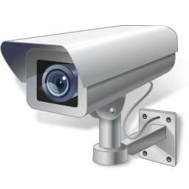
Hardware Security
The term hardware security refers to the protection of physical systems from harm. Although the term software security is more known hardware security is just as important.
Here are a few examples on how hardware security can be enforced.
Encrypt devices with any sensitive material on them. Encryption offers multiple layers of security, even if attackers get their hands on encrypted hardware, they won't be able to gain access to it without having the credentials
Investigate vendors and suppliers before purchasing any products. The production of faulty hardware components can expose vulnerable devices to outside threats.
Having a scanning system for identity verification to enter secure locations. Keeping a log of any previous scans will allow administrators to trace any security threats that may have happened.
Placing CCTV cameras in a secure area e.g. servers room. Placing a CCTV camera looking at the door will allow administration to view a potential breach of the room before it happens.

Slide 41
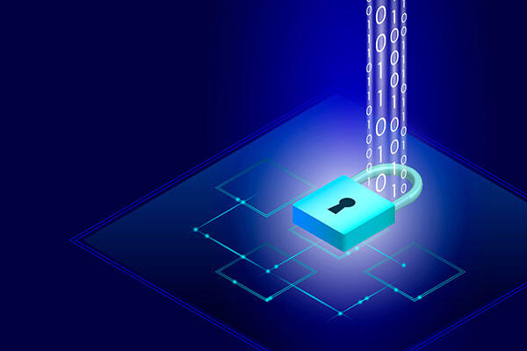
Software Security
Software security is the protection of software applications and digital experiences from unauthorised access. Software security ensures that the data is always protected. It also helps protect against vulnerabilities like malware and ransomware attacks.
Pros | Cons
It Protects against hackers. | It can be expensive.
Software security protects against malware and ransomware attacks. | Software security campaigns can be time consuming
Its protects sensitive data | It requires ongoing maintenance

Slide 42
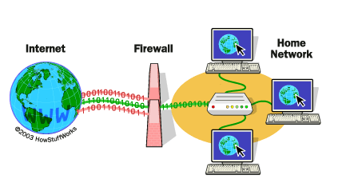
Firewalls
Firewalls are another great piece of security for networks. Using a firewall will protect your network from any unwanted viruses and hackers. The firewall monitors all incoming and outgoing network traffic and will permit or block packets based on a set of security rules.
Firewalls can either be software or hardware, though it’s best to have both. A software firewall is a program installed on each computer and regulates traffic through port numbers and applications, while a physical firewall is a piece of equipment installed between your network and gateway.

Slide 43
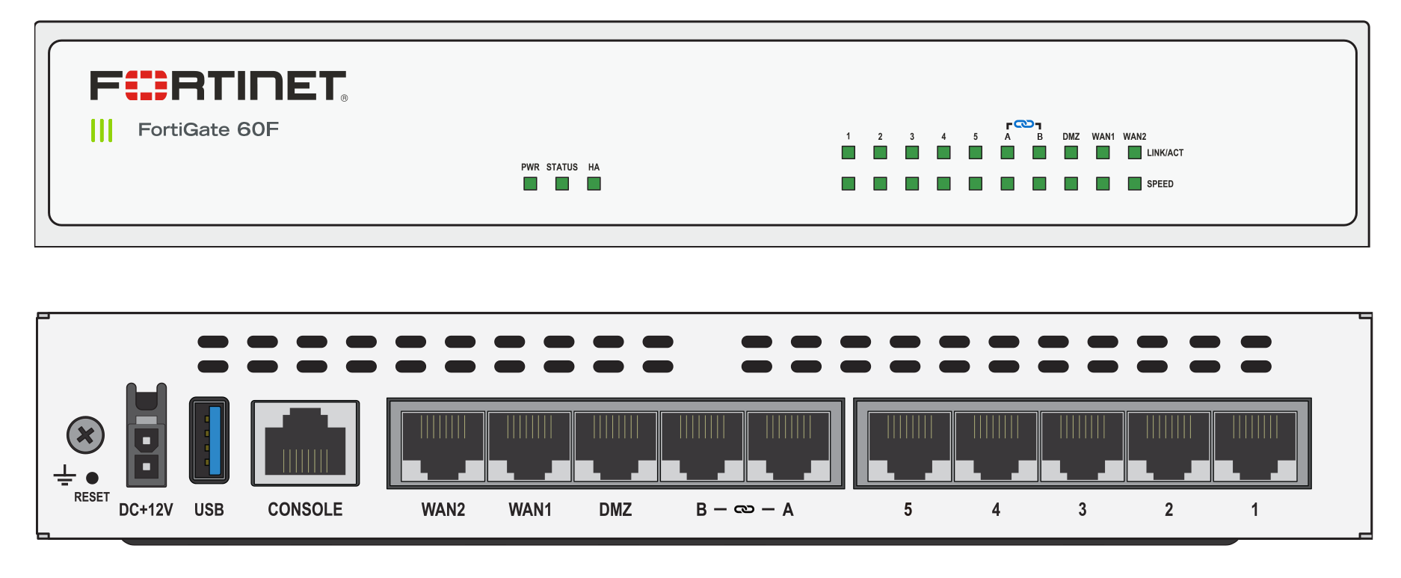
Basic Layout of Physical Firewall Device
Power Cord goes in here.
Connect modem here.
Connect switch here.

Slide 44

Proxy Servers
Proxy servers are often combined with firewalls. A proxy server is used to retrieve data from an Internet source, such as a webpage, on behalf of a user. They serve as extra data security barrier that protects users from dangerous online behaviour.
A standard proxy server configuration works as follows:
A user enters a website's URL into their browser.
The proxy server receives the user's request.
The proxy server forwards the request to the web server.
The web server sends a response (website data) back to the proxy server.
The proxy server forwards the response to the user.

Slide 45
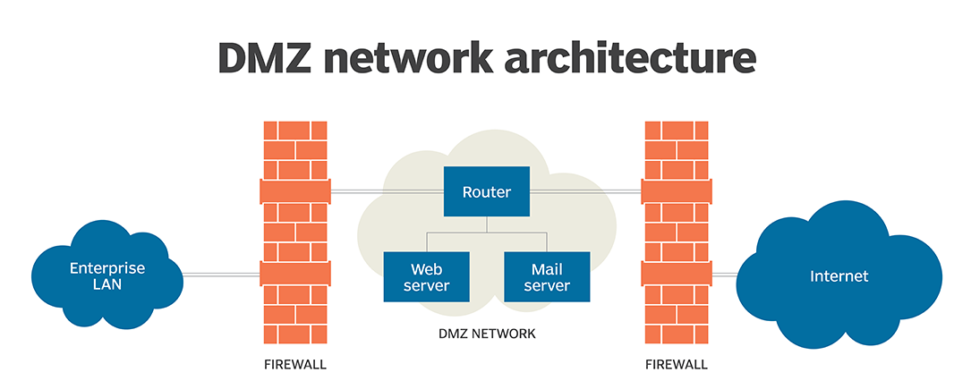
DMZ (demilitarized zone)
You may not always want to completely block remote users access to your server. In this case a DMZ will be more suitable. A DMZ will offer remote users access to certain secure services, while maintaining a buffer between those users and your internal network.

Slide 46
Lan Design
Design Report

Slide 47
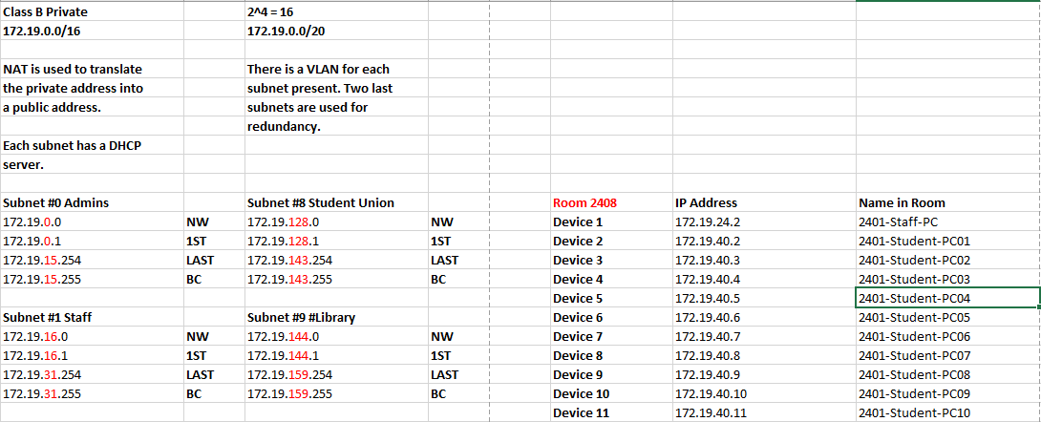
Design Report
For our Lan design a lot of time and care had to be involved in the design and creation of our plan.
The goal of our Lan was to explore and highlight the inner networking infrastructure of the college including all server and wiring locations. In addition, our group also investigated both the networks security systems and the systems email and communications network.
Redundancy
In total our Lan contains from 0 to 15 subnets, 0 to 13 which cover vital areas of the network with the remaining 2 being used for redundancy in-case of an error or crash. The redundancy is a critical part of the system as it provides a safety to the system in the event of a critical error. These errors could occur for several reasons such as a faulty wire or network traffic collision.
Fig 1 : Snippet of Subnets used in the system.

Slide 48
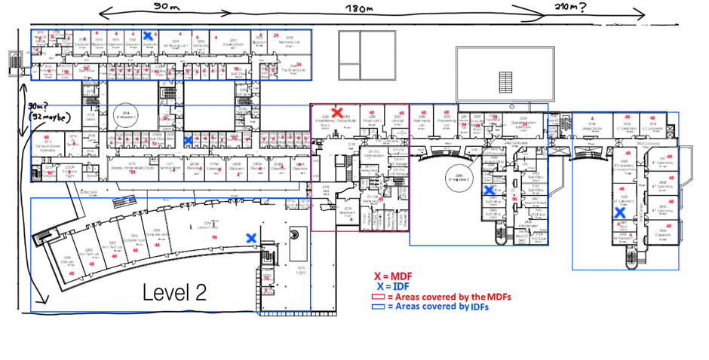
Scalability
The system we have designed is built in a way that allows for itself to be replicated and built on, in a manageable and scalable manner. It features several IDF’s spaced out around the central MDF to cover the greatest number of end users with the least IDF’s used therefore reducing both the cost and labour of installing additional IDF’s.
Our design had our MDF located centrally inside the college meaning that every IDF would only have to travel the same relative distance, therefore reducing the amount of cable needed .
Fig 2 : A map showing our placement of our MDF and IDF’s

Slide 49
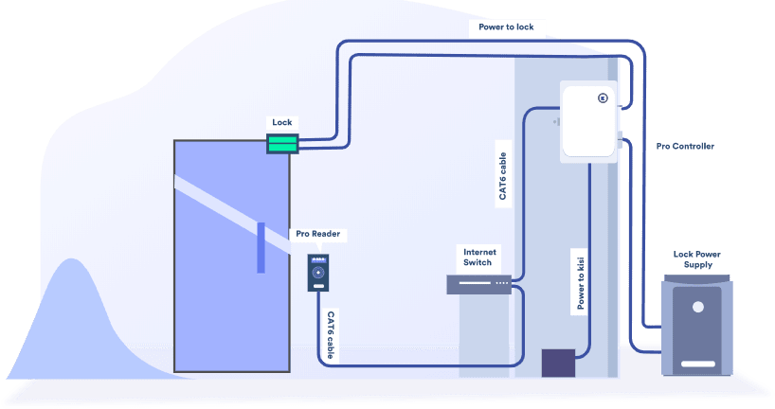
Security
The security of our system was also a critical point of our assignment as it is vital for any network in general especially one that uses and shares sensitive information about its users must have trustworthy and reliant security measures in place in case of a breach or attack.
The protection of our physical servers was also a concern as it is important that no one with malicious intent is allowed access to the servers. That is why all servers are placed inside heavily secure and monitored rooms.
Fig 3: standard example of server room security system

Slide 50
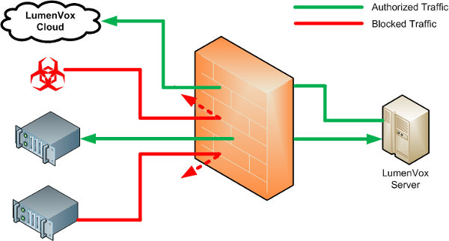
For our system we used primarily firewalls to safeguard our network. Firewalls act as a gatekeeper for the network checking each packet that appears and compares it to a basic set of rules and either allows it to execute if it complies with the set rules or it is discarded and not allowed access to the system if it does not comply with the rules set upon it.
Having safeguards for our network is also vital as it prevents either with bad intentions doing malicious activates on our network possibly endangering peoples personal or private data. It can also prevent people from accidentally accessing unknown and malicious websites that could potentially lead to viruses infecting the system and by extension the whole network.
Fig 4: Shows an example of a firewall monitoring what traffic gets to the server.

Slide 51
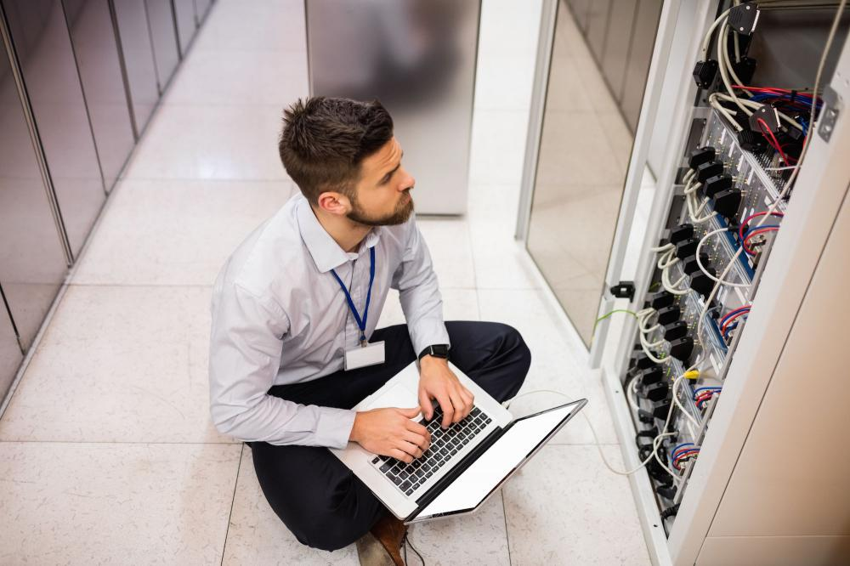
Fig 5: Server Technician monitoring a server
Manageability
Our system would theoretically be managed by the colleges server technicians who would supervise and oversee the running and stability of the network. The manageability of our network was also taken into account as we looked for the most streamlined and efficient way of covering the most area with the least amount of IDF’s.
The technician's job would be to monitor the status of the servers as well as general trouble fixing in case of any network traffic errors or collisions. They are also responsible for the configuration and implementation of new servers as well as, if need be, updating current servers in case of new patch.

Slide 52
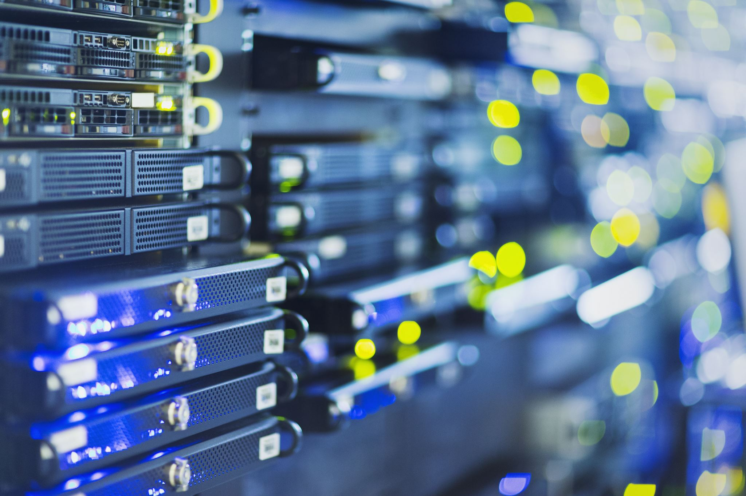
Convergence
The convergence for our network involves providing network access to multiply different types of services inside the college including the printing services, data services specifically for the servers and lastly the general media service for pcs to email and access the internet.
Convergence is implemented into our network as it allows for a simple and consistent service as it is carried out on a single simple network therefore increasing our ability to scale our network and heavily streamline the inner workings.

Slide 53
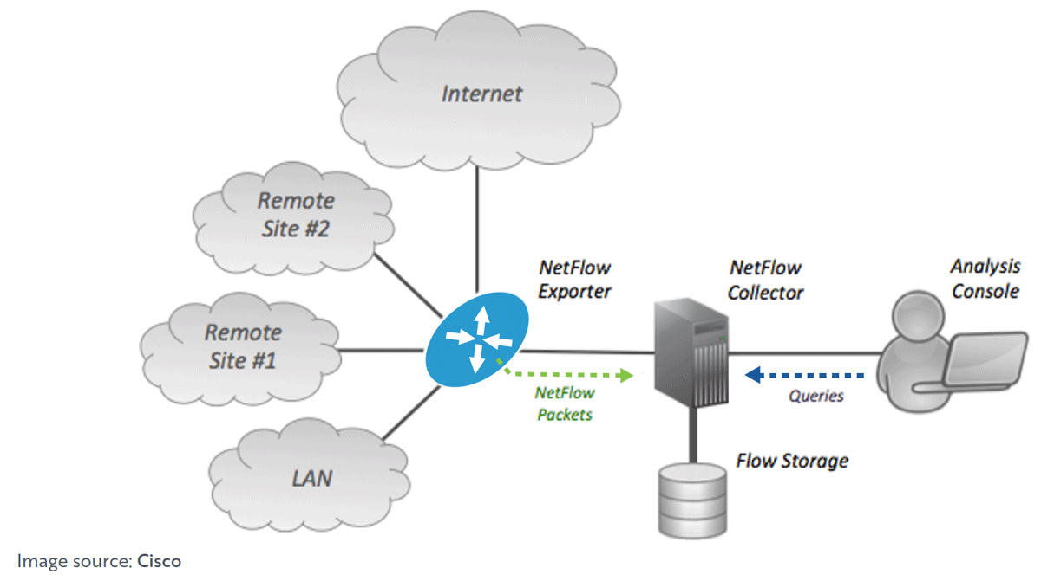
Traffic analysis
Our system also incorporates traffic analysis which is a service that is used to monitor the flow of traffic through the network, such as security risks and anomalies. We determine a packages threat level by checking where it came from and whether it is a trusted domain or not. If it is, the package is allowed to progress and if it is flagged as malicious an alert will be made and the package will be blocked and stopped from executing.
Traffic analysis is also useful for keeping logs and archiving the traffic activity of a network in real-time. This is useful when a technician needs to check whether or not a server is working correctly and allowing the traffic to move to where it needs to go.
Fig 6: A simple example of traffic analysis

